Slide 1

Varendra University
Dept. of Computer Science & Engineering (CSE)
Logic, Shift and Rotate Instructions (Chapter-7)
Course Title: Microprocessor and Assembly Language
Course No: CSE 3205
Prepared By:
Md. Adnan Sami
Lecturer, Dept. of CSE, VU

Slide 2
Outline
  Logic Instruction.
  AND, OR, XOR Instruction.
  Converting an ASCII Digit to a Number.
  Converting a Lowercase to Upper Case.
  Clearing a Register.
  Testing a Register for Zero.
  NOT Instruction.
  TEST Instruction.
  Shift Instruction.
  Rotate Instruction.
  Application of Shift and Rotate Instruction.

Slide 3
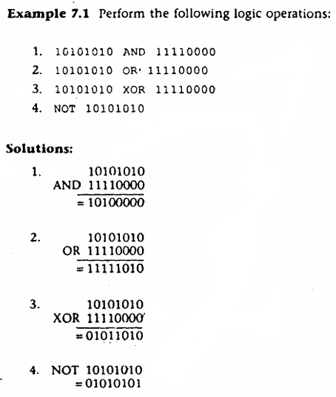
Logic Instruction

Slide 4
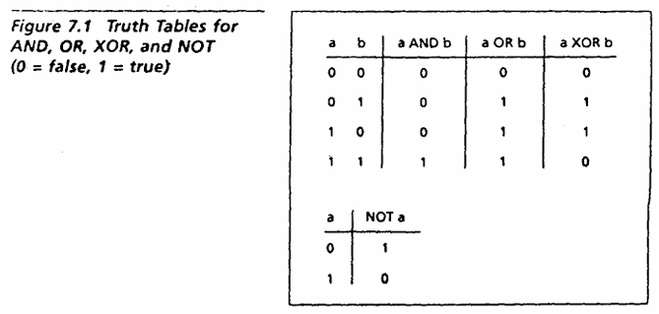
Logic Instruction

Slide 5
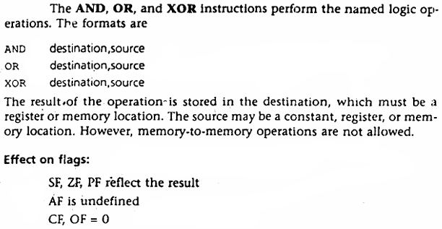
AND, OR, XOR Instruction

Slide 6
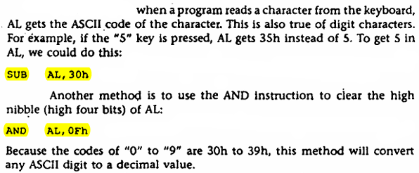
Converting an ASCII Digit to a Number

Slide 7
Converting a Lowercase to Upper Case
  The ASCII codes of "a" to "z" range from 61h to 7Ah.
  The ASCII codes of "A" to "Z" range from 41h to 5Ah.

Slide 8
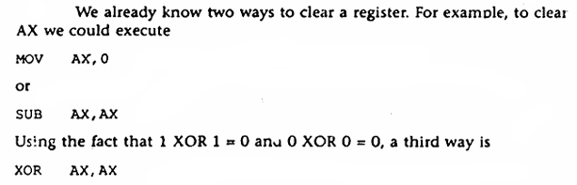
Clearing a Register

Slide 9
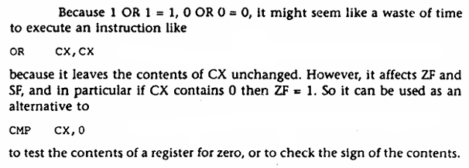
Testing a Register for Zero

Slide 10
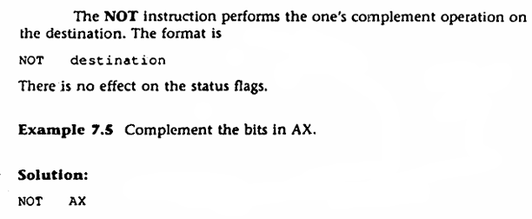
NOT Instruction

Slide 11
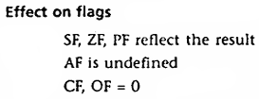
TEST Instruction
  The TEST instruction performs an AND operation of the destination with the source but does not change the destination contents. The purpose of the TEST instruction is to set the status flags.
  The format is,

Slide 12
Shift Instruction
  The shift and rotate instructions shift the bits in the destination operand by one or more positions either to the left or right.
  For a shift instruction, the bits shifted out are lost.
  For a rotate instruction, bits shifted out from one end of the operand are put back into the other end.
  For a single shift rotate, the format is,
  For a shift or rotate of N positions, the format is,
  Where CL contains N.

Slide 13

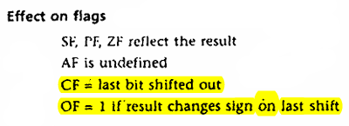
Shift Instruction
  Left Shift Instruction:
  The SHL (shift left) instruction shifts the bits in the destination to the left. The format for a single shift is,
  If the shift count N, the format is,
  Where CL contains N.

Slide 14
Shift Instruction
  Left Shift Instruction:
  Example 7.7: Suppose DH contains 8Ah and CL contains 3. What are the values of DH and of CF after the instruction SHL DH,CL is executed?
  Solution:
  MOV DH, 8Ah
  MOV CL, 3
  SHL DH, CL
  The binary value of DH is 10001010. After 3 left shifts, CF
  will contain 0. The new contents of DH may be obtained by erasing the leftmost three bits and adding three zero bits to the right end, thus 01010000b = 50h.

Slide 15
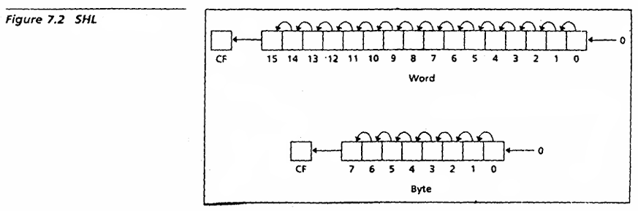
Shift Instruction
  Left Shift Instruction:

Slide 16
Shift Instruction
  Right Shift Instruction:
  The SHR (shift right) instruction shifts the bits in the destination to the right. The format for a single shift is,
  SHR destination, 1
  If the shift count N, the format is,
  Where CL contains N.

Slide 17
Shift Instruction
  Right Shift Instruction:
  Example 7.9: Suppose DH contains 8Ah and CL contains 2. What are the values of DH and of CF after the instruction SHR DH,CL is executed?
  Solution:
  MOV DH, 8Ah
  MOV CL, 2
  SHR DH, CL
  The binary value of DH is 10001010. After 2 right shifts, CF = 1. The new contents of DH may be obtained by erasing the rightmost two bits and adding two zero bits to the left end, thus 00100010b = 22h.

Slide 18
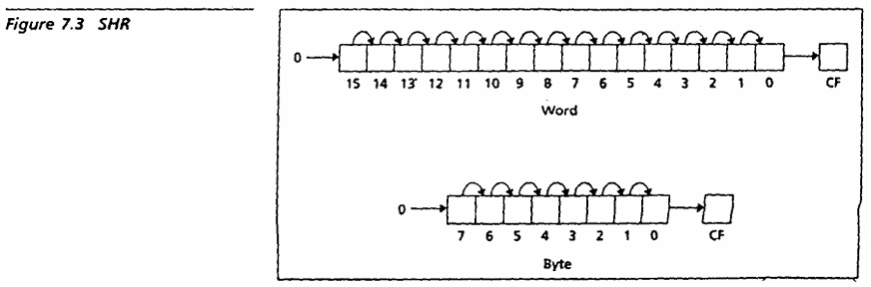
Shift Instruction
  Right Shift Instruction:

Slide 19
Shift Instruction
Shift Operation
Left Shift
Right Shift

Slide 20
Shift Instruction
  Left Shift : Multiply a number by 2
  Right Shift : Divide a number by 2
0 | 0 | 0 | 0 | 0 | 1 | 0 | 0
0 | 0 | 0 | 0 | 1 | 0 | 0 | 0
  4*2 = 8

Slide 21
Shift Instruction
  Left Shift : Multiply a number by 2
  Right Shift : Divide a number by 2
0 | 0 | 0 | 0 | 0 | 1 | 0 | 0
 | 0 | 0 | 0 | 0 | 0 | 0 | 1 | 0
  4/2 = 2

Slide 22

Rotate Instruction
  Rotate Left:
  The instruction ROL (rotate left) shifts bits to the left. The MSB is shifted into the rightmost bit. The CF also gets the bit shifted out of the MSB. The syntax is,

Slide 23
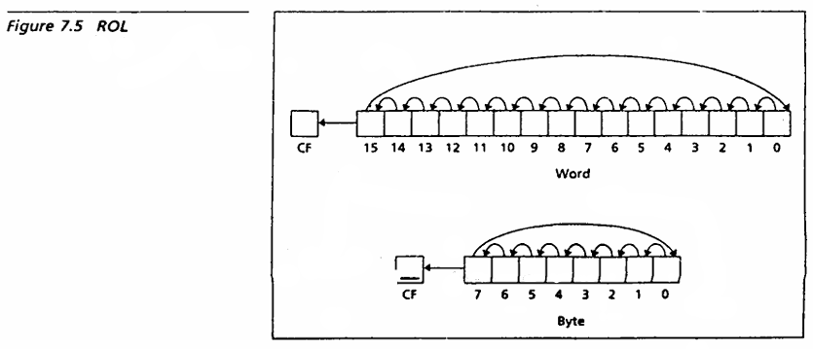
Rotate Instruction
  Rotate Left:

Slide 24
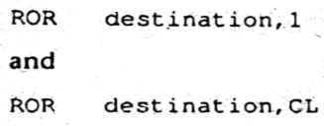
Rotate Instruction
  Rotate Right:
  The instruction ROR (rotate right) works just like ROL, except that the bits are rotated to the right. The rightmost bit is shifted into the MSB, and also into the CF. The syntax is,

Slide 25
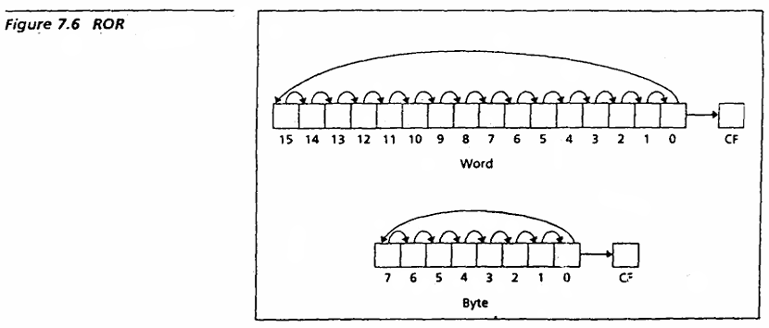
Rotate Instruction
  Rotate Right:

Slide 26

Rotate Instruction
  Rotate Carry Left (RCL):
  The instruction RCL (Rotate through Carry Left) shifts the bits of the destination to the left. The MSB is shifted into the CF, and the previous value of CF is shifted into the rightmost bit. In other words, RCL works like just like ROL, except that CF is part of the circle of bits being rotated. The syntax is,

Slide 27
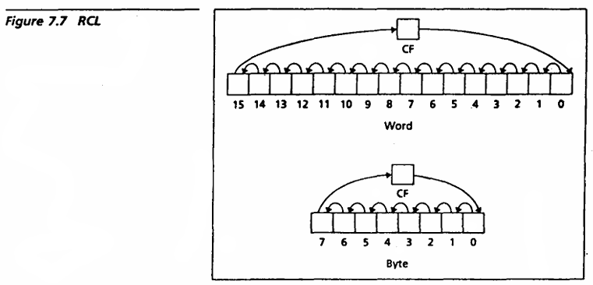
Rotate Instruction
  Rotate Carry Left (RCL):

Slide 28

Rotate Instruction
  Rotate Carry Right (RCR):
  The instruction RCR (Rotate through Carry Right) works just like RCL, except that the bits are rotated to the light. The syntax is,

Slide 29
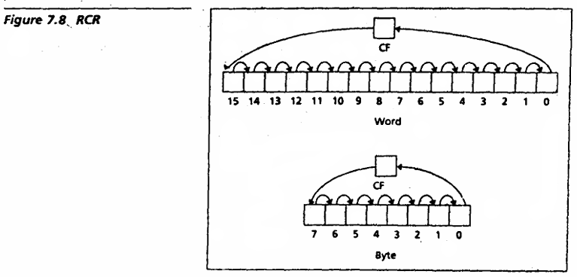
Rotate Instruction
  Rotate Carry Right (RCR):

Slide 30
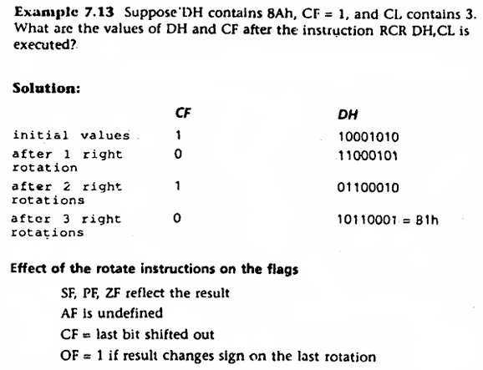
Rotate Instruction

Slide 31
Rotate Instruction
  ROL
  RCL
  ROR
  RCR
0 | 0 | 0 | 0 | 0 | 1 | 1 | 0
  Binary Value is 6

Slide 32
Rotate Instruction
  ROL/RCL
0 | 0 | 0 | 0 | 0 | 1 | 1 | 0
0
0 | 0 | 0 | 0 | 1 | 1 | 0 | 0
  Binary Value is 12

Slide 33
Rotate Instruction
  ROR/RCR
0 | 0 | 0 | 0 | 0 | 1 | 1 | 0
0 | 0 | 0 | 0 | 0 | 0 | 1 | 1
0
  Binary Value is 3

Slide 34
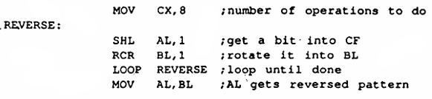
Application of Shift and Rotate Instruction
  Reversing Bit Pattern.
  The code is,

